Slide 1
SQL INJECTIONS
By S rohan

Slide 2

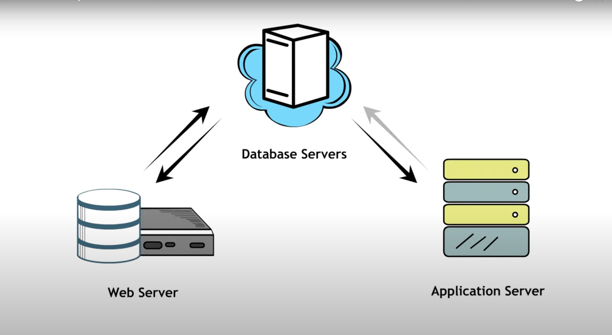
What is SQL injection?
SQL injection is a code injection technique attackers use to gain unauthorized access to a database by injecting malicious SQL commands into web page inputs.
Attackers can extract sensitive information, modify database data, execute administration operations on the database (such as shutdown DBMS), recover the content of a given file present on the DBMS file system, and in some cases, issue commands to the operating system.

Slide 3
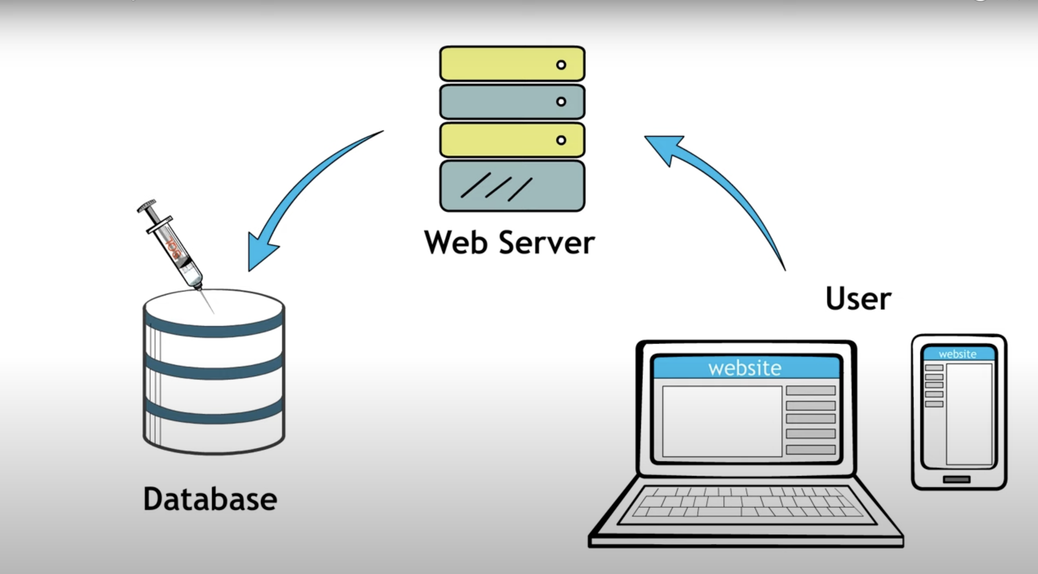
How attackers exploit SQL
An attacker can inject SQL control characters and command keywords (e.g., single quote (‘), double quote (“), equal (=), comment (- -), etc.) to change the query structure. Using these control characters with common SQL commands (e.g., SELECT, FROM, DELETE, etc.) enables access or retrieval of data elements from a backend database server.

Slide 4
Best Practices to Prevent SQL Injection
Use Prepared Statements (with Parameterized Queries): Ensure that SQL code is defined, and then pass each parameter to the query later.
Stored Procedures: Execute database commands directly within the database server, separating SQL code from data.
Input Validation: Validate and sanitize all user inputs to ensure they conform to expected formats.
Least Privilege: Limit the database user's permissions to only what is necessary for the application.
Use ORM (Object-Relational Mapping): Utilize frameworks that manage database queries to avoid manual SQL handling.
Regular Security Testing: Perform code reviews and penetration testing to identify and address vulnerabilities.

